Slide 1

Computer Science != Software Engineering
Tamer Avci - CS540/485
Author: Chuck Connell

Slide 2
Table of Contents
Introduction
Contrast
Big Question 0
Big Question 1
Fine Line
Connells’ Thesis
Objections
Conclusion and some humble advice

Slide 3
Computer science and software engineering ask different questions
Computer Science:
Is P = NP?
Is there an algorithm which can determine whether or not an arbitrary polynomial equation in several variables has solutions in integers?
Can you simulate everything on a Turing machine?
...who cares?
Software Engineering doesn’t. Well, to a certain extent.
Softwares solve problems that humans have.
Softwares run with minimum amount of errors.
Softwares that we can use in daily life and make money with.

Slide 4
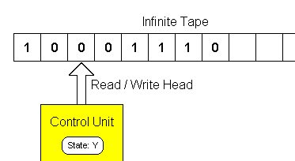
Software engineering still uses computer science
Of course.
We need software that solves a certain problem in reasonable time and reasonable cost.
For that you need complexity theory. Oh wait a second. I took that class in undergraduate.
Rubber meets the road
Does computer science need SE?
Not really. Because Church-Turing thesis. :)

Slide 5
Computer science and software engineering is concerned with different processes
Curriculum for CS:
Introductory CS
Assembly - C
Data Structures
Algorithms
Theory of Computing
Systems Programming
Software Engineering:
Requirements
Design
Implementation
Testing
Clean
Well defined
Analyzed and proven
Each one building on earlier stuff
Slippery
Imperfect results
Always changing
results defined in general
fashionable

Slide 6
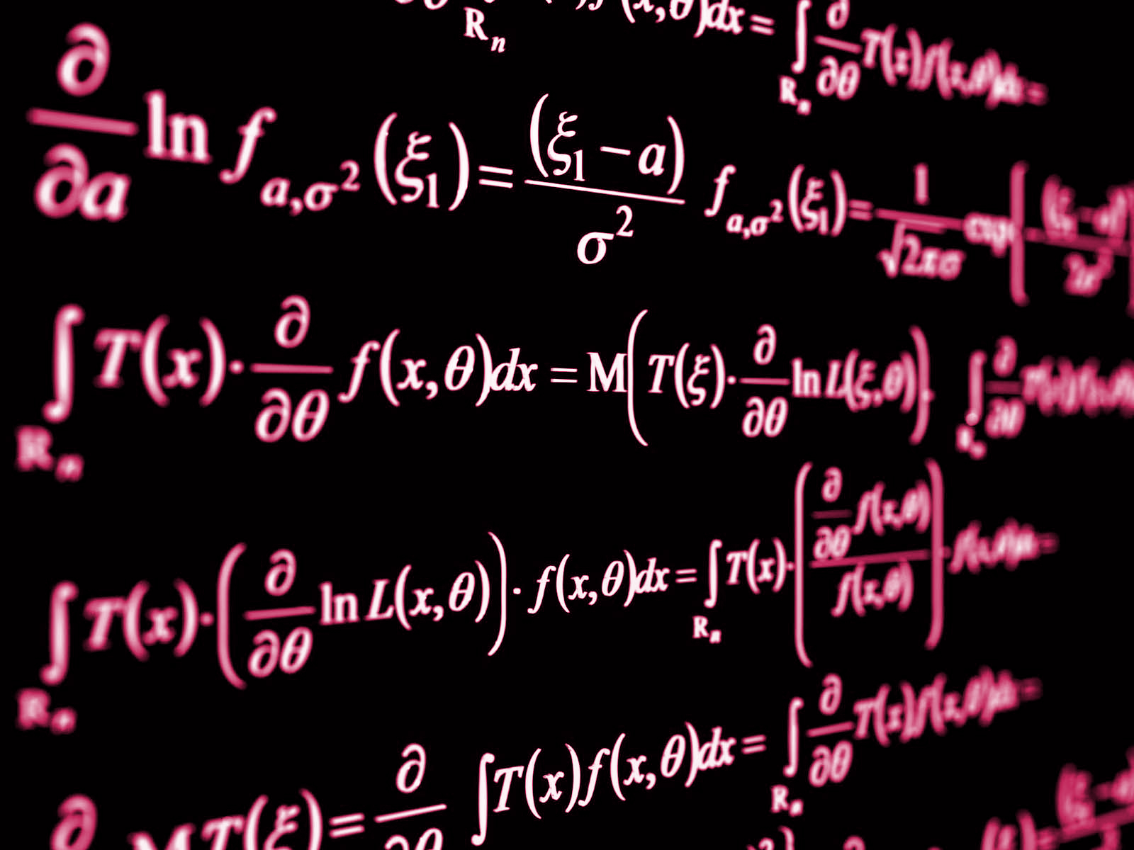
Big Question 0:
“Why can't software engineering have more rigorous results, like the other parts of computer science?
To state the question another way, "How much of software design and construction can be made formal and provable?"

Slide 7
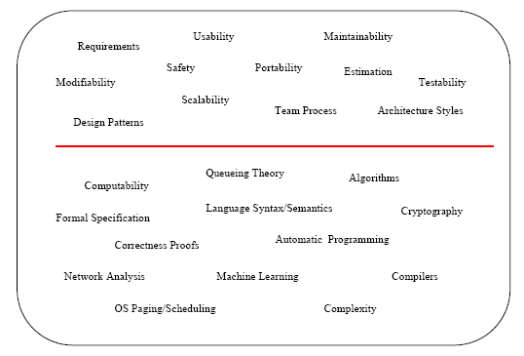
Answer lies in the following diagram
Big Question 1:
“What property does that red line have?”

Slide 8

Software engineering has an essential human component
Software engineering has this property, while traditional computer science does not. The results from disciplines below the line might be used by people, but their results are not directly affected by people
HUMAN ACTIVITY
Maintainability
Requirements
Safety

Slide 9
Which brings us to Connell’s thesis..
“Software engineering will never be a rigorous discipline with proven results, because it involves human activity. “
Extra-mathematical statement
No proof
No proof for no proof

Slide 10
Just because it cannot be formulated formally, is it useless?
Classical computer science NOT whole story.
Creativity
Vision
Multi-disciplinary thinking, and humanity.
Physical architecture vs structural engineer
“We should not try to make software engineering into an extension of mathematically-based computer science. It won't work, and can distract us from useful advances waiting to be discovered.”

Slide 11
Advice: Liberal arts college vs. technical college
Thank you for listening!
Q & A

